Slide 1
INTRODUCTION &
FUNDAMENTALS OF ROCKET PROPULSION
BY
T.MOHANREDDY

Slide 2
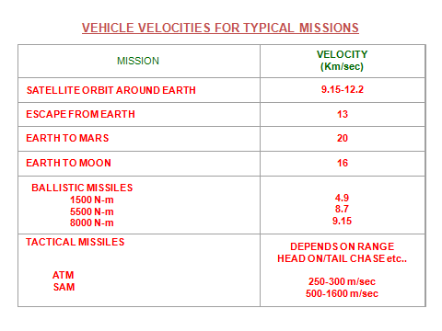

Slide 3
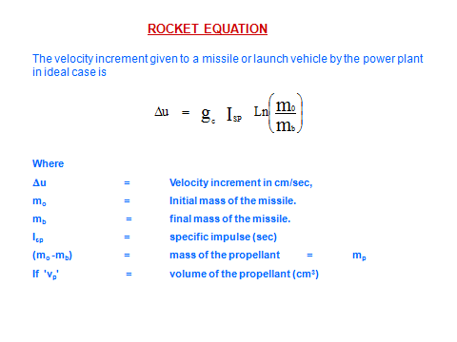

Slide 4
ROCKET PROPULSION
Propulsion ( Greek word ) propellerie pellerie---push: pro--- forward
Propulsion------push forward
Pushing object in space- rocket propulsion.
or
Imparting momentum(mass*velocity) to the object in space.

Slide 5
SPACE SPACE IS END LESS
1.5 x10 galaxies in observable space
one galaxy in wich we belong is milkyway
it consists of---large no.of stars,dark matter ,dust ,gas,black holes etc
its diameter is 1000 light years (10 km) width is 250 light years
Solar system -one star sun &8 planets (mercury,venus,earth,mars,jupitor,saturn,urinus, nephune)

Slide 6
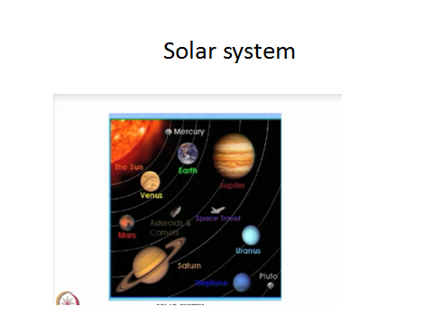

Slide 7
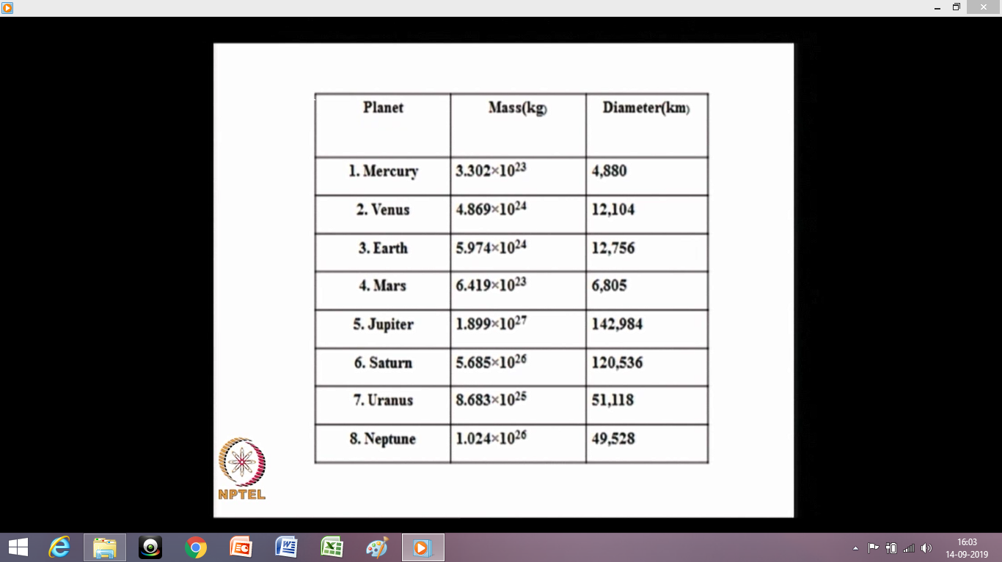

Slide 8
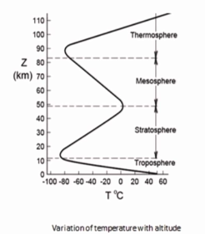

Slide 9
ROCKET
Rocket/ Missile :Is a device to deliver payload to the desired destination
Propulsion system is one of the major sub systems of a rocket or missile
Propellant produces high thermal energy and converts this to transnational kinetic energy by ejecting low molecular weight combustion products through nozzle to achieve propulsive thrust
Most common propulsion system – chemical propulsion
Propellants: Solid/ liquid/ Hybrid system according to their physical state with their own merits and demerits
Energy wise liquid propellants are superior to solid propellants.

Slide 10
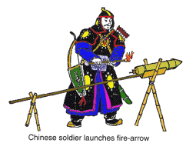

Slide 11
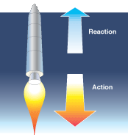
Gasses Rocket
Action Reaction

Slide 12

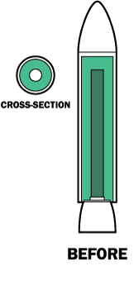

Slide 13
SOLID ROCKET MOTOR FUNDAMENTALS
Solid Rocket Motor Comprises of
Metallic / Composite Casing
Thermal Insulation
Solid Propellant
Nozzle
Head end
Retainer ring
Prop. Supporting grids
Igniter
Pyro cartridges
SOLID ROCKET MOTOR

Slide 14
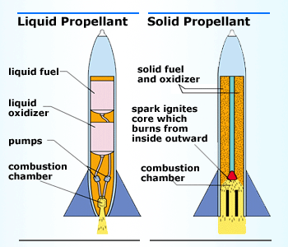
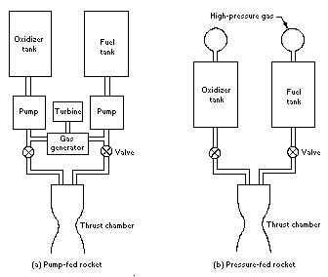
The Liquid Propellant Rocket
Constructions:
Liquid/solid

Slide 15

Liquid rocket engine

Slide 16
ADVANTAGES OF SOLID MOTORS
SIMPLE DESIGN.
NO PREPERATION TIME.
FEW OR NO MOVING PARTS.
READY TO OPERATE QUICKLY.
WILL NOT LEAK, SPILL OR SLOSH.
LESS OVERALL WEIGHT FOR LOW IMPULSE APPLICATION.
CAN PROVIDE VERY HIGH THRUST FOR SHORT DURATIONS.
LONG STORAGE LIFE.
LESS SAFETY HAZARDS.
CAN BE RECOVERED AND REUSED AFTER REFURBISHMENT OF PROPELLANTS.
THRUST VECTOR CONTROL POSSIBLE.
LESS PRONE TO COMBUSTION INSTABILITY.
CAN BE PRODUCED IN LARGE NUMBERS. (FEW LAKHS PER YEAR)
CAN PROVIDE ATTITUDE CONTROL AND DIVER THRUST FROM SAME MOTOR FOR AD APPLICATIONS

Slide 17
DISADVANTAGES OF SOLID MOTORS
NO MULTI START CAPABILITY. (TWO START POSSIBLE)
LIMITED THRUST MODULATION.
LESS SPECIFIC IMPULSE COMPARE TO CRYO.
LARGE MOTORS TRANSPORTABILITY LIMITATION.
ENVIRONMENTAL POLLUTION FOR LARGE BOOSTERS WITH COMPOSITE PROPELLANTS
DETEORATION DUE TO AGEING.
VARIATION OF PERFORMANCE WITH TEMPERATURE.

Slide 22
MILESTONES FOR THE DEVELOPMENT OF ROCKETS , MISSILES AND
SPACE VEHICLES IN INDIA
YEAR | EVENT
1963 | USA LAUNCHED 1ST SOUNDING ROCKET FROM THUMDA(THUMBA EQUATORIAL ROCKET LAUNCHING STATION) FOLLOWING BY FRENCH,SOVIET,BRITSH ROCKET LAUNCHER BETWEEN 1963-75
1967 | LAUNCH OF 1ST INDIAN MADE SOUNDING ROCKET ROHINI-75
1980 | 1ST LAUNCH OF SLV-3
1983 | LAUNCHING OF IGMPD-DRDO/DRDL
1988 | 1ST TEST FLIGHT OF PRITHVI MISSILE
1989 | 1ST TEST FLIGHT OF AGNI MISSILE
1991 | 1ST ASLV LAUNCH
1994 | 1ST PSLV LAUNCH
1999 | AGNI-II LAUNCH
2000 | DANUSH MISSILE LAUNCH
2001 | GSLV LAUNCH BROHMOS

Slide 23
YEAR | EVENT
2008 | CHANDRAYAN &AGNI-III
2011 | AGNI-IV
2012 | AGNI-V
2013 | MARS ORBITAL MACHINE (MOM)-PSLV
2014 | GSLV-GSAT-14
2015 | GSLV-D6
2016 | AAD interceptor
2017 | PSLV G37 104 satellites
2018 | AGNI 5
2018 | GSLV MAK3
2019 | GSLV MAK3 CHANDRAYAN2

Slide 24
CLASSIFICATION OF SOLID ROCKET MOTORS
Sno.
BASIS
EXAMPLES
1
APPLICATION
SPACE BOOSTER, ICBM, TACTICAL MISSILES, AIR DEFENCE APPLICATIONS, GAS GENERATORS.
2
DIAMETER AND LENGTH
LARGE, SMALL
3
PROPELLANT
DOUBLE BASE, COMPOSITE, CMDB, NITRAMINE
4
CASE DESIGN
METAL, COMPOSITE
5
GRAIN
END BURNING, INSIDE TO OUTSIDE, OUTSIDE TO INSIDE, MULTI GRAIN, MULTI PERFORATED, SLOTTED TUBE, FINOCYL, CONO-CYL ETC. SEGMENTED MONOLITHIC.
6
GRAIN INSULATION
CASE BONDED, CARTRIDGE / LOADED
7
THRUST ACTION
NEUTRAL, PROGRESSIVE, REGRESSIVE,
DUAL THRUST
8
TOXICITY
TOXIC AND NON-TOXIC EXHAUST GASES.

Slide 25
MAJOR APPLICATION CATEGORIES OF SOLID ROCKET MOTORS
CATEGORY
APPLICATIONS
TYPICAL CHARACTORISTICS
BALLISTIC MISSILE DEFENCE
DEFENCE AGAINST LONG & MEDIUM RANGE BALLISTICS MISSILES.
BOOSTER, DIVERT THRUSTER, MULTIPLE ATTITUDE CONTROL AND SMALL UPPER MANEUVERABLE STAGE
GAS GENERATORS
PUSH MISSILES FROM SUBMARINE LAUNCH TUBES & LAND MOBILE CANISTERS.
LOW TEMP GASES,
HIGH PRESSURE FOR LOW TIME,
THRUST IS NOT IMPORTANT
AUXILIARY PROPULSION
SYSTEM
RETRO MOTORS, ULLAGE MOTORS AND NOSE CONE SEPARATION MOTORS
LOW THRUST,
LOW BURN TIME
VERY SMALL THRUSTER (15 TO 50 Kg)
VERY LOW TIME (100-200 m-sec)
MICRO THRUSTERS
ATTITUDE CONTROL

Slide 26
MAJOR APPLICATION CATEGORIES OF SOLID ROCKET MOTORS
CATEGORY
APPLICATIONS
TYPICAL CHARACTORISTICS
BALLISTIC MISSILE DEFENCE
DEFENCE AGAINST LONG & MEDIUM RANGE BALLISTICS MISSILES.
BOOSTER, DIVERT THRUSTER, MULTIPLE ATTITUDE CONTROL AND SMALL UPPER MANEUVERABLE STAGE
GAS GENERATORS
PUSH MISSILES FROM SUBMARINE LAUNCH TUBES & LAND MOBILE CANISTERS.
LOW TEMP GASES,
HIGH PRESSURE FOR LOW TIME,
THRUST IS NOT IMPORTANT
AUXILIARY PROPULSION
SYSTEM
RETRO MOTORS, ULLAGE MOTORS AND NOSE CONE SEPARATION MOTORS
LOW THRUST,
LOW BURN TIME
VERY SMALL THRUSTER (15 TO 50 Kg)
VERY LOW TIME (100-200 m-sec)
MICRO THRUSTERS
ATTITUDE CONTROL

Slide 27
MISSILE
Missile is always guided, while Rocket does not have guidance
(However INS/GPS Guidance are being adopted for Rocket and Bombs to reduce the cost of target engagement)
PRESENTATION COVERS
  Parts of Missiles
  Classification of missile
  Guidance and Navigation used in Missiles
Torpedo is also a under water Missile adopting different Technology for Guidance – SONAR, Propulsion by Batteries

Slide 28
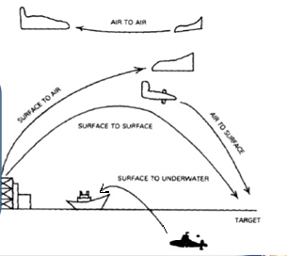
MISSILE IS CLASSIFIED BASED ON:
CLASSIFICATION | TYPES
LAUNCH PLATFORM | SAM(AKASH), SSM(AGNI), AAM(ASTRA), ASM(ARM)
TARGET ENGAGEMENT | Antitank (NAG), Anti Aircraft(ASTRA), Anti Ship (Brahmos) Anti Radars (NGARM)
RANGE | SR, MR, LR, ER (ATGM’s) SRBM, MRBM, IRBM & ICBM (Strategic Missiles)
GENERATION | ATGM-(Wire Guided, Semi Automatic, Automatic/Fire and Forget or Lock on before launch)

Slide 29
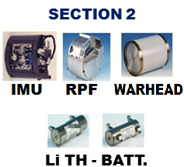
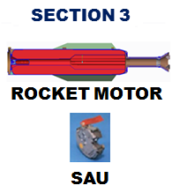
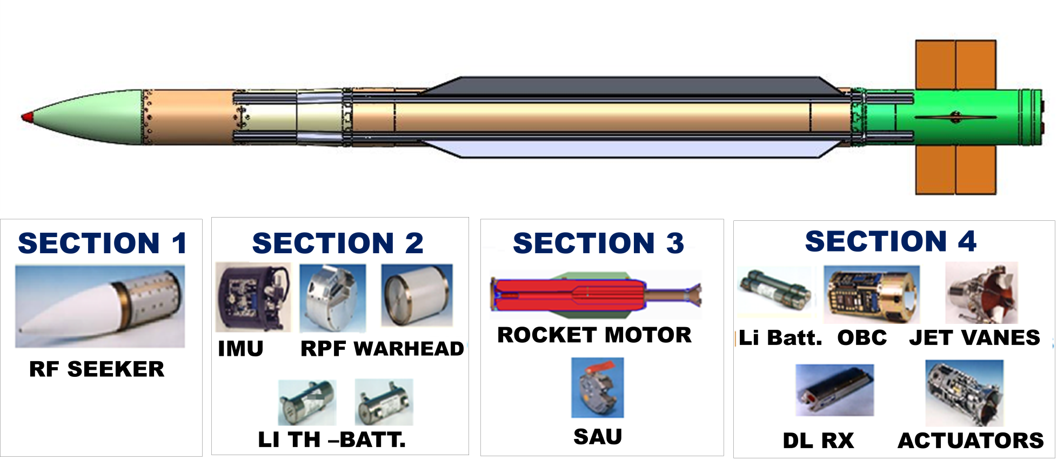
PARTS OF MISSILES

Slide 30
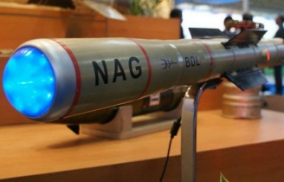
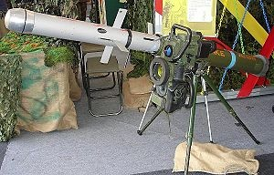
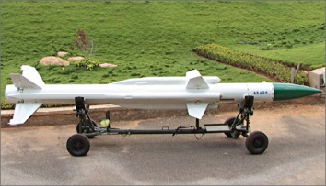
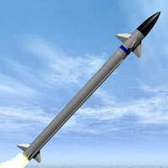
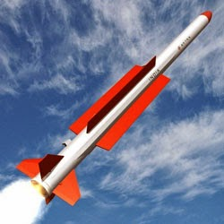
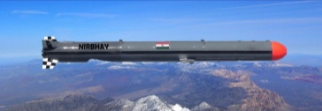
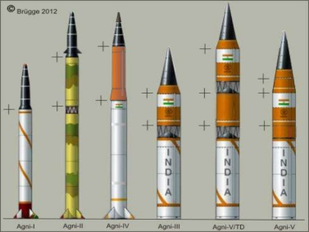
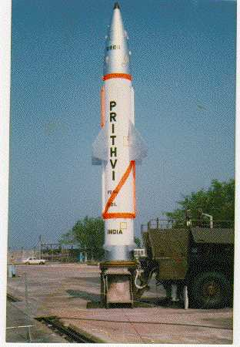
CLASSIFICATION OF MISSILES:
ANTI TANK GUIDED MISSILE (ATGM) | NAG/HELINA, SPIKE MR, LR, ER
SURFACE TO AIR MISSILE (SAM) | AKASH, LRSAM, MRSAM
AIR TO AIR MISSILE (AAM) | ASTRA, R-70, R-63
AIR TO SURFACE (ASM) | NIRBHAY
SURFACE TO SURFACE (SSM) | AGNI-I, II, III, IV & V PRITHVI-I, II,III & DHANUSH, K-15

Slide 31
MISSILE | RANGE KM | AIRFRAME | PROPULLSION /PROPELLANT |  | GUIDANCE | SEEKER | WARHEAD
ATGM
KONKORS-M | 4.0 | Al. Alloy (HE-15) & Composite FRP | Solid / DB | Wire Guidance |  | NA | Tandem
NAG | 4 | Al-Alloy (HE-15) | Solid / DB (NCNG-RDX) | Seeker |  | IIR Seeker (Imaging Infrared ) | Tandem
HELINA | 7 | Al-Alloy (HE-15) | Solid / DB (NCNG-RDX) | Seeker |  | IIR Seeker | Tandem
SPIKE MR | 2.5 | Al-Alloy (HE-20) | Solid / DB Composite | Seeker |  | IIR Seeker | Tandem
SPIKE LR | 4.0 | Al-Alloy (HE-20) | Solid / DB Composite | Seeker |  | IIR/CCD (Charge coupled Device) | Tandem
SPIKE ER | 8.0 | Al-Alloy (HE-20) | Solid / DB Composite | Seeker |  | IIR/CCD | Tandem

Slide 32
MISSILE | RANGE KM | AIRFRAME | PROPULLSION /PROPELLANT |  | GUIDANCE | SEEKER | WARHEAD
AAM
ASTRA | 80-110 | HE-20+ MDN-250 |  | Solid / Composite | INS+RF SEEKER | RF (KU-BAND) | Pre fragmented
ASTRA MK-II | 120+ | HE-20+ MDN-250 |  | Solid / Composite | INS+RF SEEKER | RF (KU-BAND) | Pre fragmented
ASM
NGARM | 40 | AA2014+ MDN-250 |  | Solid / Composite | PNG+BROAD BAND RF SEEKER | Passive Seeker (1-18GHz) | Airburst / Impact
CRUISE
BRAHMOS | 300 | Al. Alloy (HE-20 &HE-15)+MDN |  | Solid Composite + Liquid Ramjet | INS+RF Seeker + RF Altimeter | X-Band | Impact
BRAHMOS-NG | 600 | Al. Alloy (HE-20&HE-15)+MDN |  | Solid Composite + Liquid Ramjet | INS+RF Seeker + RF Altimeter | X-Band | Impact

Slide 33
MISSILE | RANGE KM | AIRFRAME | PROPULLSION /PROPELLANT | GUIDANCE | SEEKER | WARHEAD
SAM
AKASH | 25 | HE-20+ MDN-250 | Solid /Composite (Ramjet) | CLOS (command to line of site) | NA | Pre Fragmented
AKASH S | 25 | HE-20+ MDN-250 | Solid /Composite (Ramjet) | CLOS + Seeker | RF (KU-Band) | Pre fragmented
AKASH NG | 70 | HE-20+ MDN-250 | Solid / Composite | CLOS + Seeker | RF (KU-Band) | Pre fragmented
MRSAM | 70 | HE-20+ MDN-250 | Solid / Composite | Inertial + Seeker | X-Band | Pre fragmented
LRSAM | 70 | HE-20+ MDN-250 | Solid / Composite | Inertial + Seeker | X-Band | Pre fragmented

Slide 34
MISSILE | RANGE KM | AIRFRAME | PROPULLSION /PROPELLANT |  | GUIDANCE | SEEKER | WARHEAD
ATGM
KONKORS-M | 4.0 | Al. Alloy (HE-15) & Composite FRP | Solid / DB | Wire Guidance |  | NA | Tandem
NAG | 4 | Al-Alloy (HE-15) | Solid / DB (NCNG-RDX) | Seeker |  | IIR Seeker (Imaging Infrared ) | Tandem
HELINA | 7 | Al-Alloy (HE-15) | Solid / DB (NCNG-RDX) | Seeker |  | IIR Seeker | Tandem
SPIKE MR | 2.5 | Al-Alloy (HE-20) | Solid / DB Composite | Seeker |  | IIR Seeker | Tandem
SPIKE LR | 4.0 | Al-Alloy (HE-20) | Solid / DB Composite | Seeker |  | IIR/CCD (Charge coupled Device) | Tandem
SPIKE ER | 8.0 | Al-Alloy (HE-20) | Solid / DB Composite | Seeker |  | IIR/CCD | Tandem

Slide 35
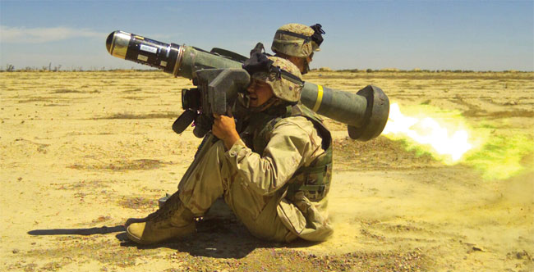
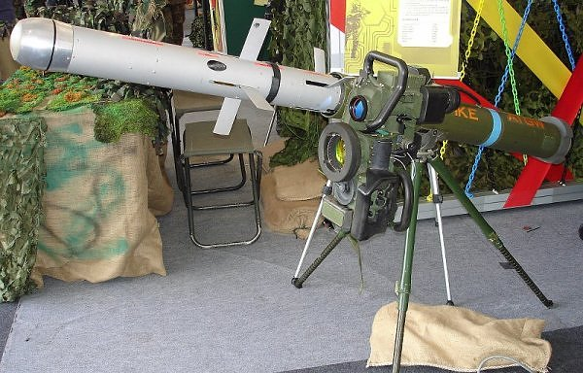
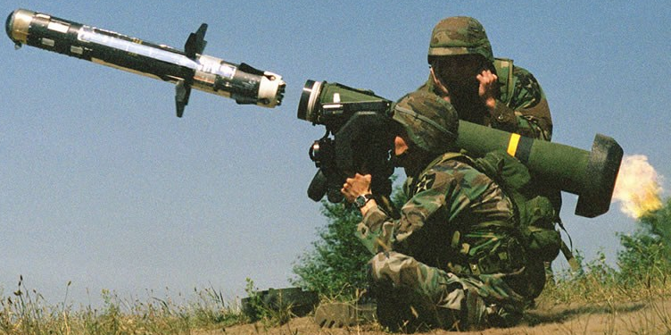
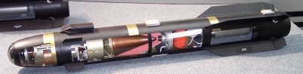
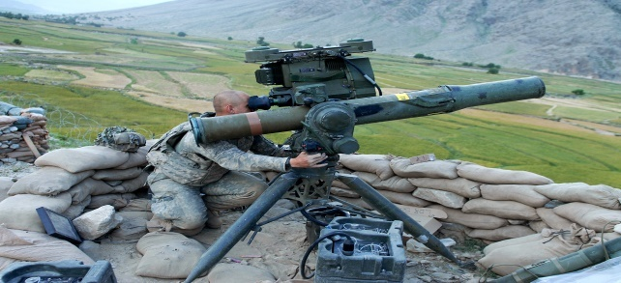
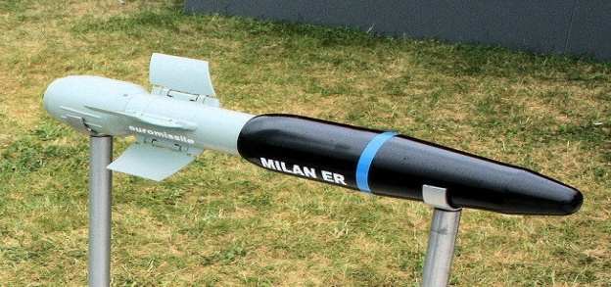
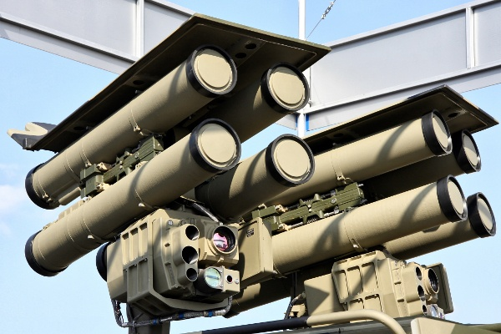
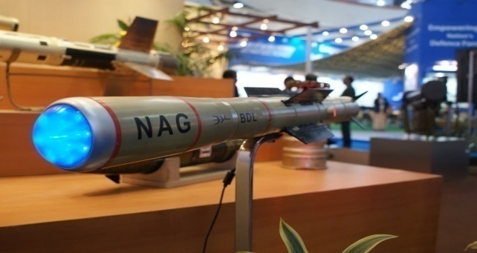
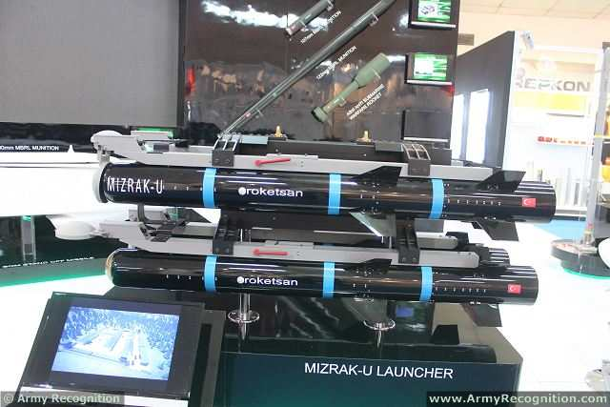
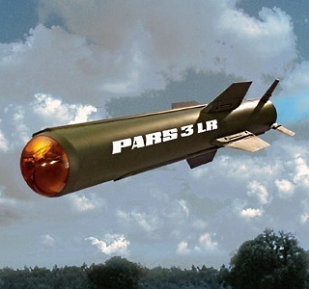
ANTITANK GUIDED MISSILES
US
ISRAEL
US
AGM-114R HELLFIRE
Spike-MR/LR/ER
Javelin Missile
US
FRANCE
RUSSIA
BGM-71 TOW
MILAN ER
Kornet-EM
INDIA
TURKISH
GERMANY
Nag (missile)
Mızrak-U
PARS 3 / TIGRAT

Slide 36
